Slide 1
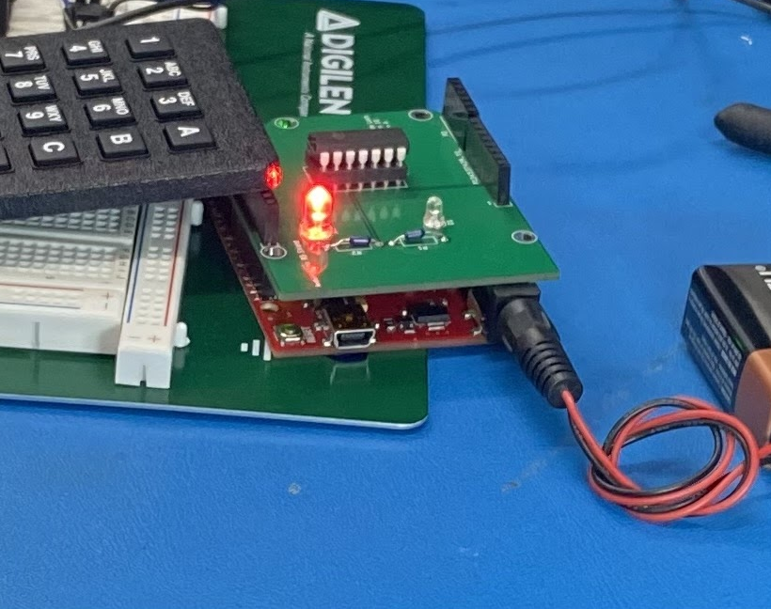
Mini Project Presentation
Carlos Callejas Dominguez 821226920
Ethan Nagelvoort 821234668
Ardiana Krasniqi 820354659
Robert Esposito 822379994
Arduino Keycode Lock

Slide 2
Summary
Mini-Project demonstrates a lock that requires a keycode to operate.
Circuit was designed with KiCAD tools and implemented on a PCB.
Circuit satisfies technical requirements.
Circuit satisfied EE 496A Mini-project assignment criteria.

Slide 3
Design Highlights
Design implements an Arduino shield for easy hook-up.
Microcontroller’s power output pins are used to drive the LM339 comparators.
Design implements a 10 second timeout if less than 4 consecutive key presses are made.

Slide 4
Key Technologies
An LM339 is used as an LED driver to turn ON and OFF a red or green LED.
The Arduino enables the LM339 to switch from logic high or logic low depending on the keycode from the user.
The code was written in C++

Slide 5
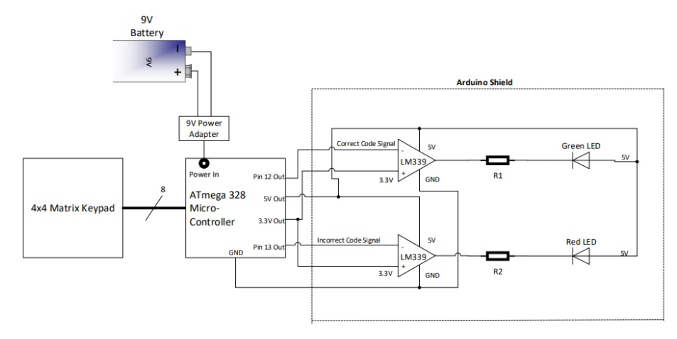
Block Diagram

Slide 6
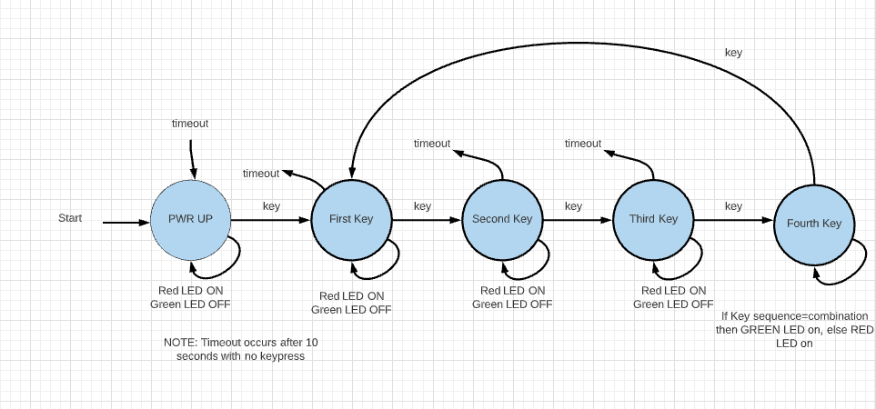
State Diagram

Slide 7
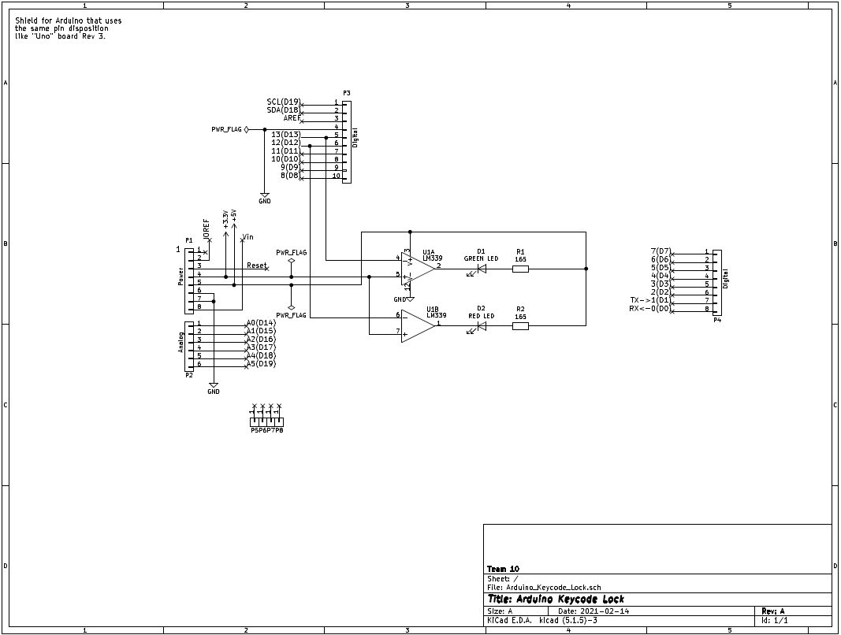
Schematic Diagram

Slide 8
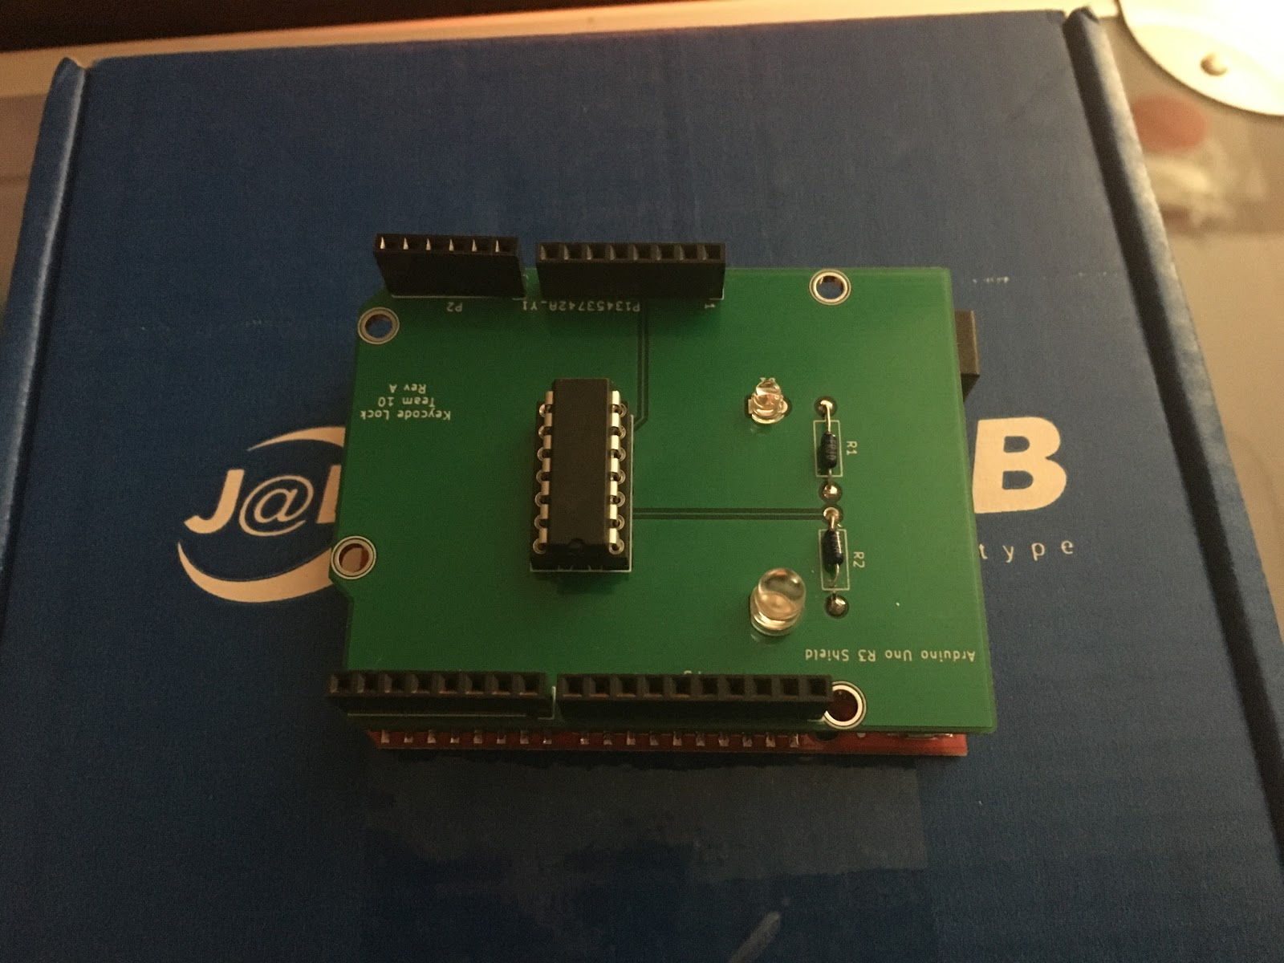
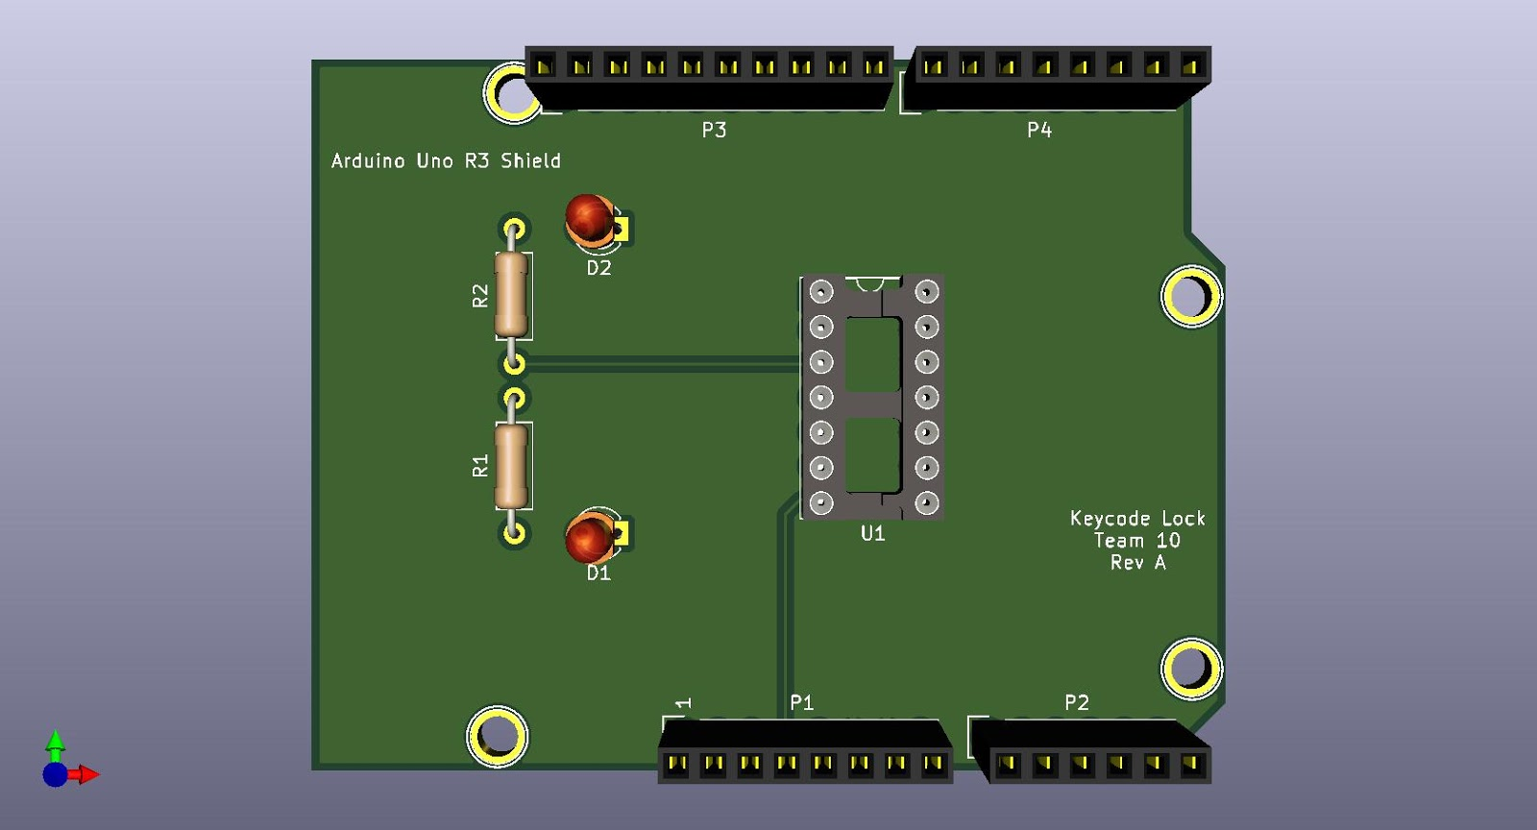
Printed Circuit Board

Slide 9
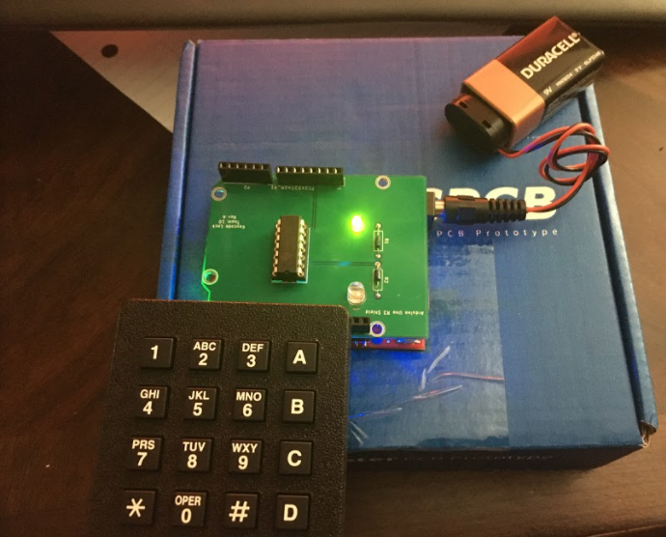
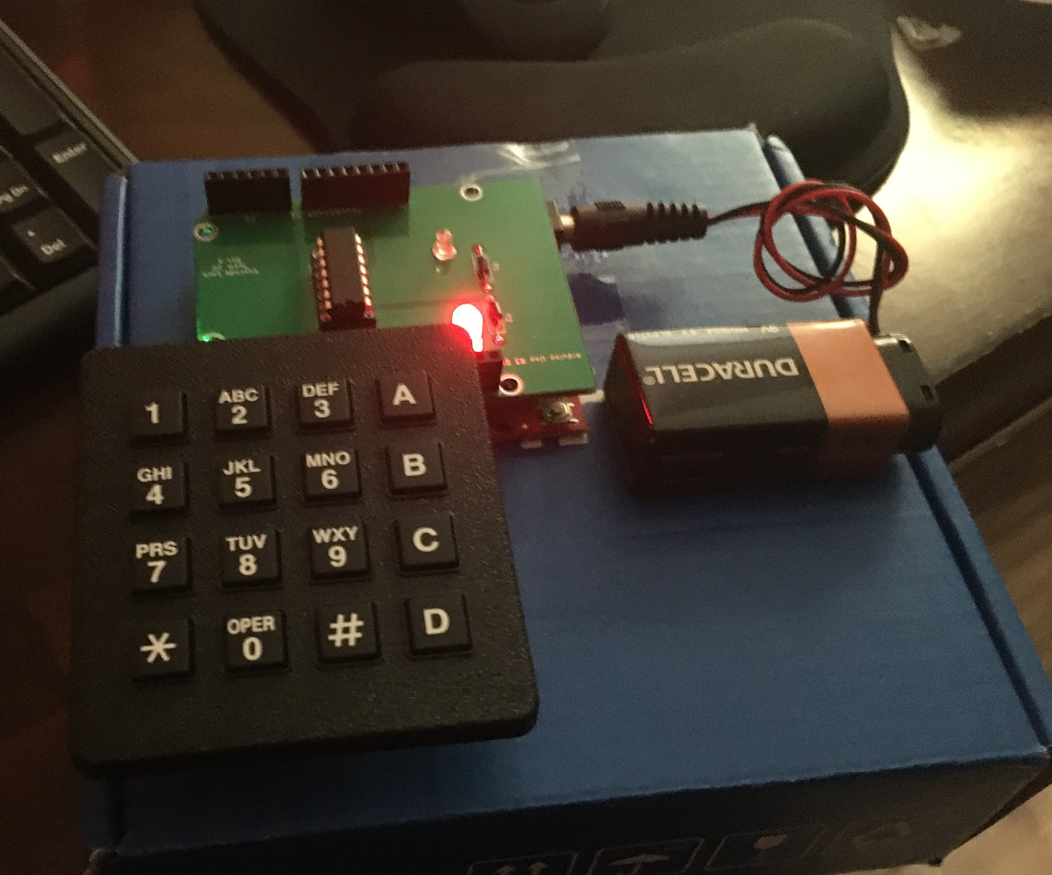
Finished PCB

Slide 10
Questions and Comments

